Slide 1
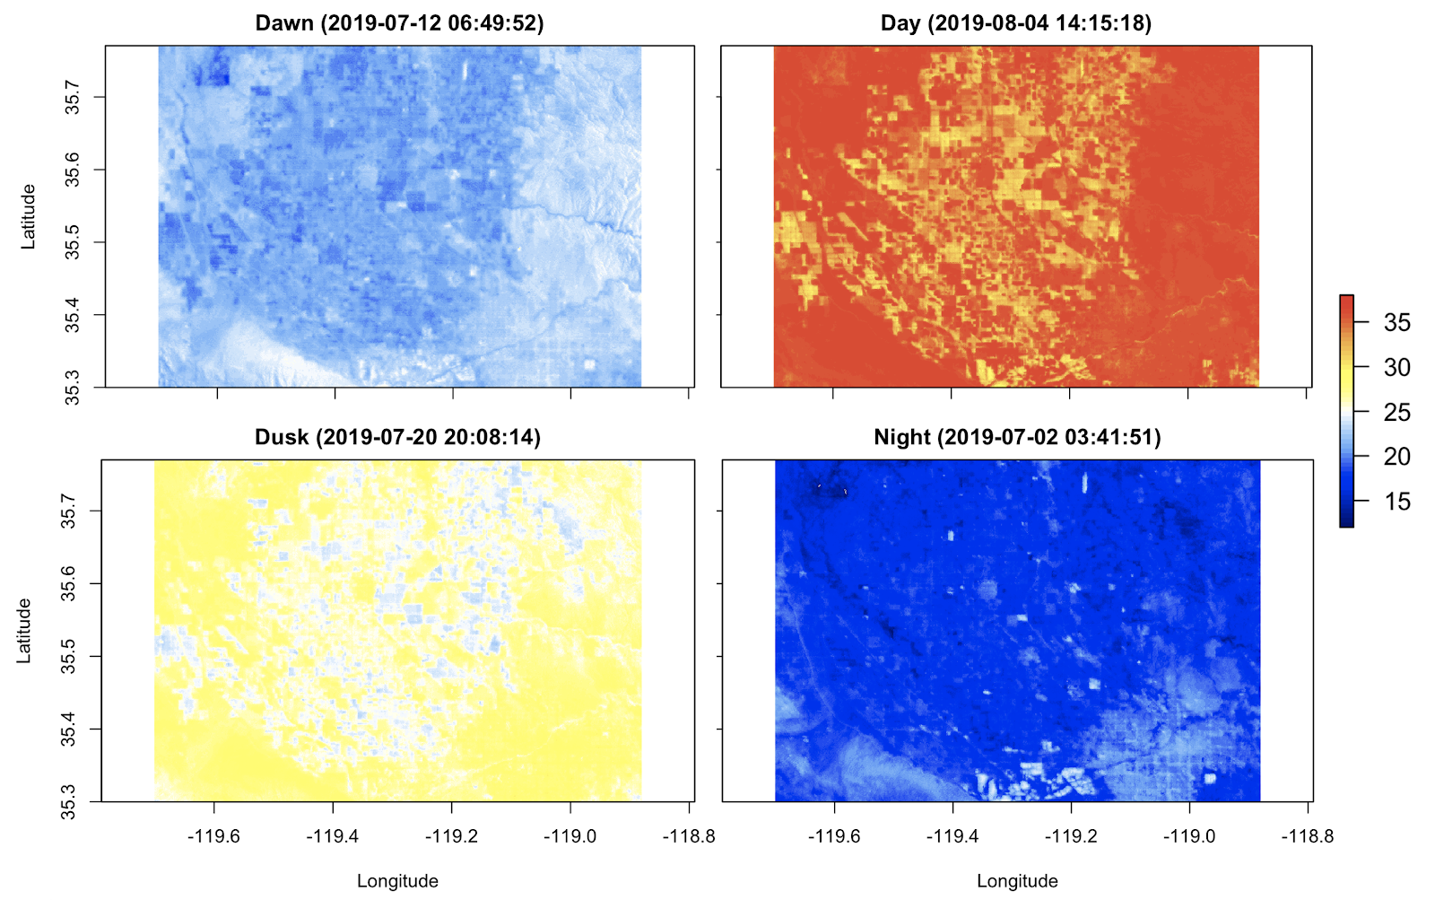
West Nile virus risk mapping using satellite derived temperature data
Anna Boser

Slide 2
Introduction
What is West Nile virus (WNV)?
WNV is a deadly mosquito transmitted disease present in California since 2003
What do we know about WNV?
We monitor where mosquitoes and humans with WNV are
What do we not know about WNV?
Where and when processes necessary for WNV transmission happen, such as mosquito biting or, assuming a bite happens, transmission.
Introduction
Conclusion
Methods
Modeling
Analysis

Slide 3
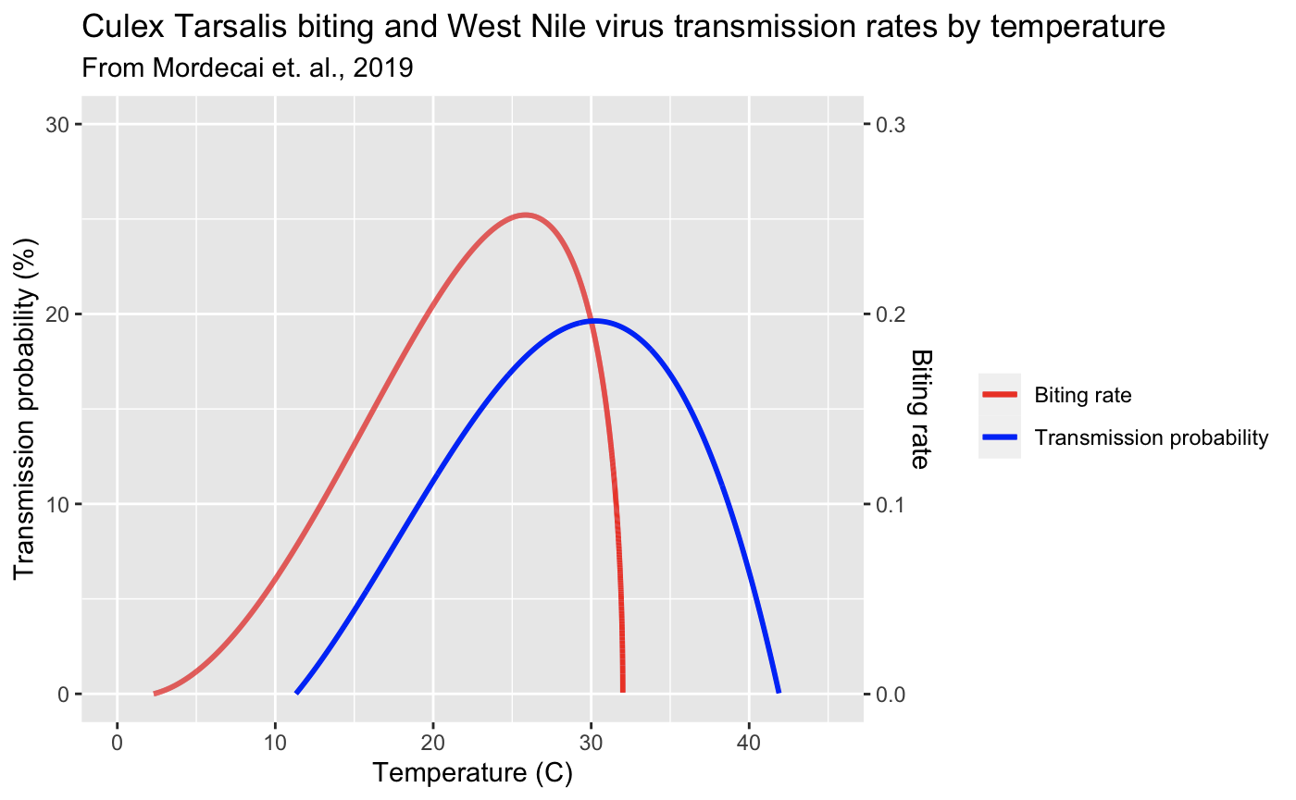
Methods
Land Surface Temperature
Air temperature modeling
Air Temperature
Laboratory derived equations
Diurnal cycle & landcover analysis
Biting and transmission rates
Question 1 (Modeling)
Question 2 (Analysis)
Introduction
Conclusion
Methods
Modeling
Analysis
Can ECOSTRESS land surface temperature estimates in conjunction with laboratory derived mosquito biting rate and WNV transmission rate relationships be used to map these variables at a high spatial resolution?
How variable are mosquito biting rate and WNV transmission potential predicted to be across land covers and diurnal temperatures?

Slide 4
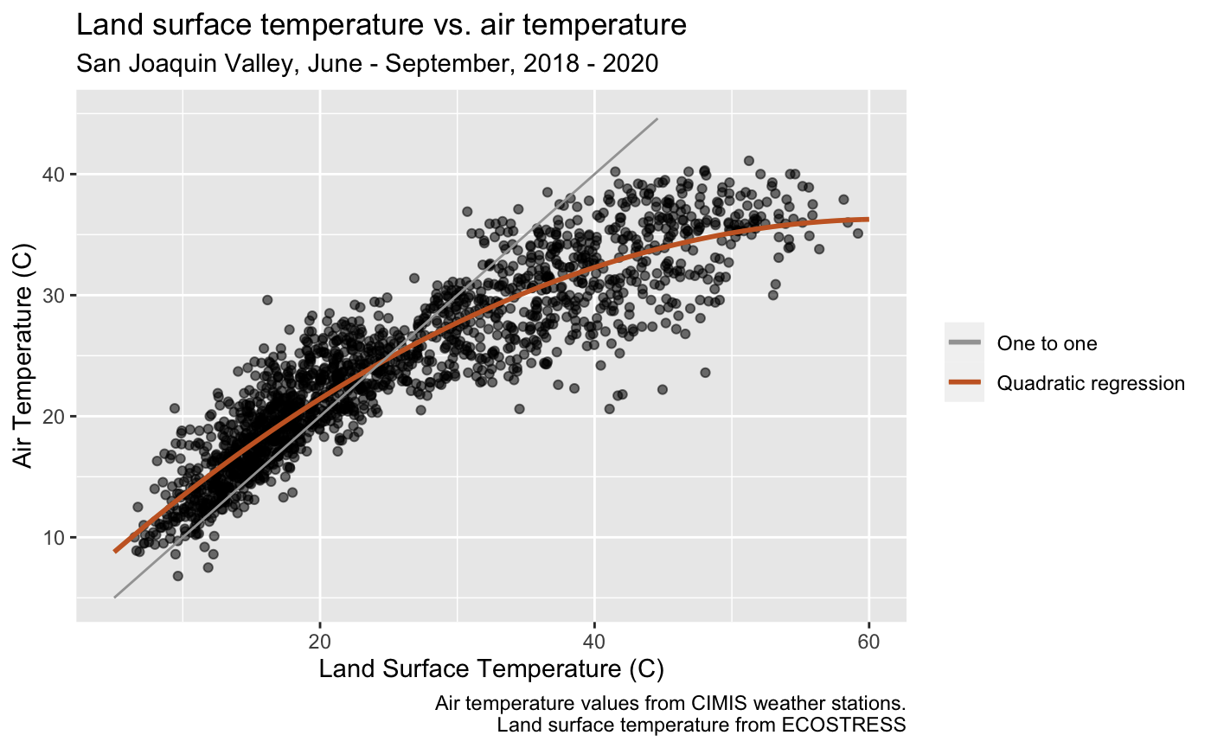
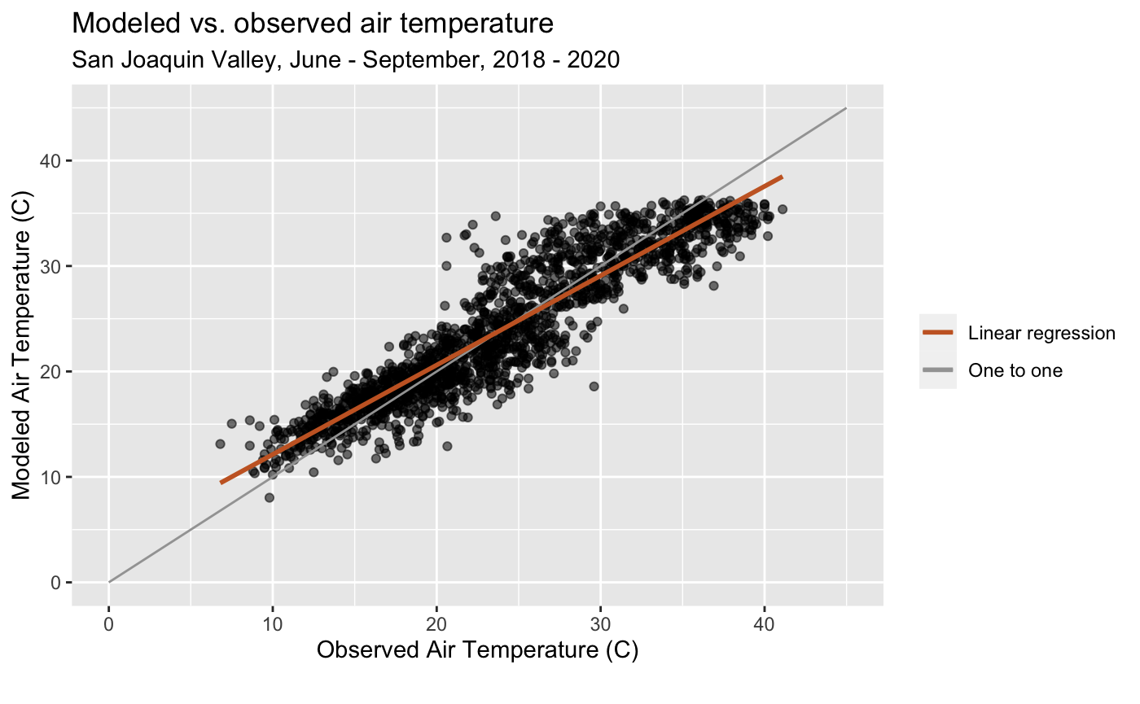
Land surface temperature to air temperature
A quadratic regression of air temperature from ground based sensors (CIMIS) on ECOSTRESS land surface temperature (LST) yields an adjusted R² of .85
Introduction
Conclusion
Methods
Modeling
Analysis

Slide 5
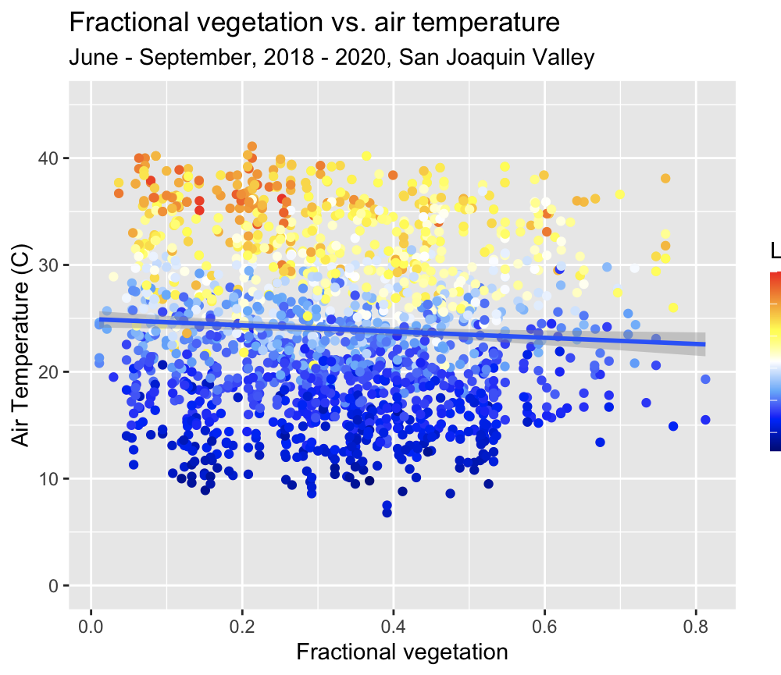
Land surface temperature to air temperature
Adjusting for fractional vegetation did not improve the regression.
Introduction
Conclusion
Methods
Modeling
Analysis

Slide 6
Air temperature to biting and transmission rates
The nonlinear relationship between temperature and risk means higher temperature only lead to higher risk to a certain threshold
Air Temperature (C)
Introduction
Conclusion
Methods
Modeling
Analysis

Slide 7
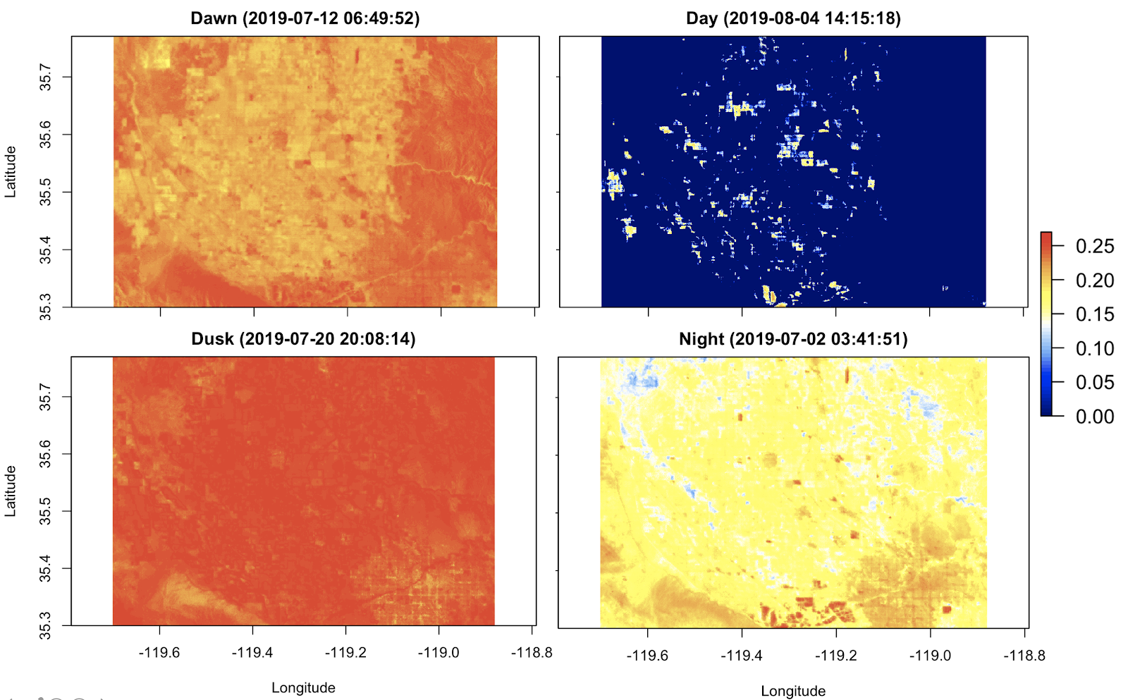
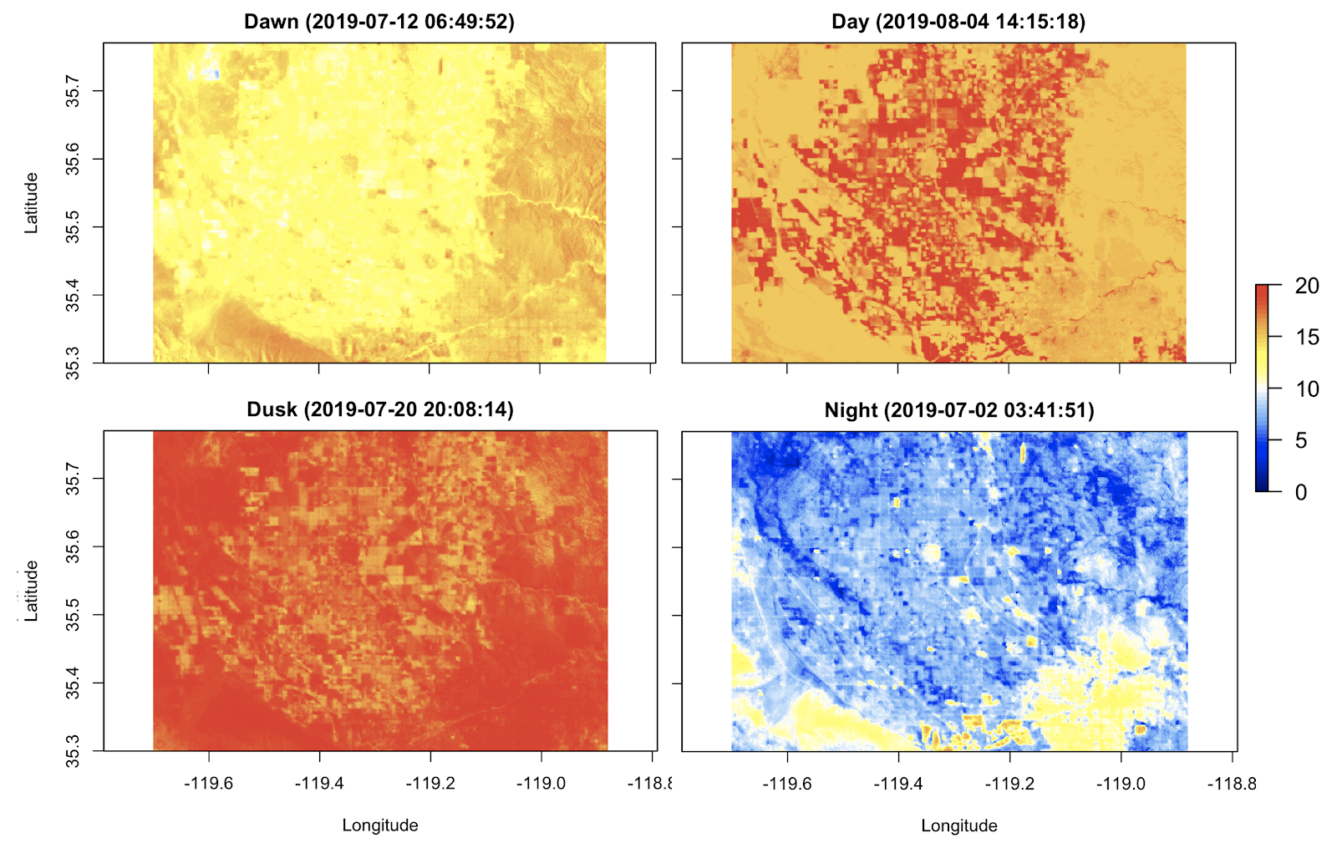
Air temperature to biting and transmission rates
The sharp drop-off of these rates after a certain temperature threshold leads to lower values during the day
Agricultural and urban areas behave distinctly
Air temperature (C)
Biting rate
Transmission probability
Introduction
Conclusion
Methods
Modeling
Analysis

Slide 8
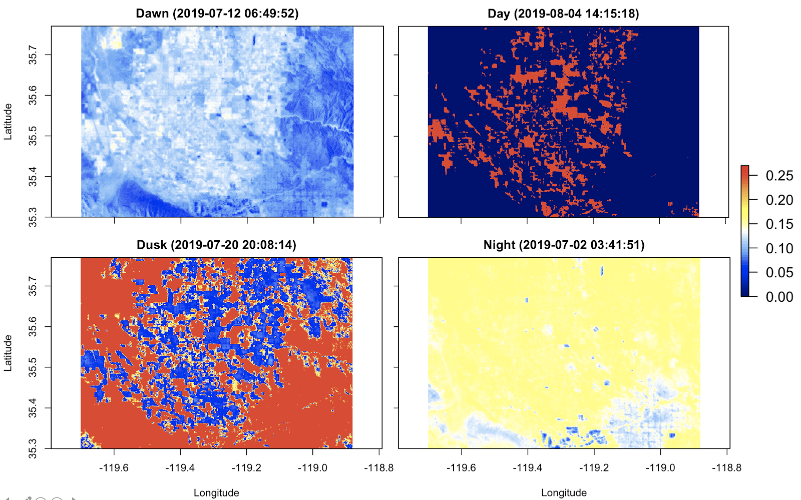
95% Confidence interval: Biting rate
The nonlinearity of the equations causes constant confidence intervals in temperature to vary when transformed to risk
Introduction
Conclusion
Methods
Modeling
Analysis

Slide 9
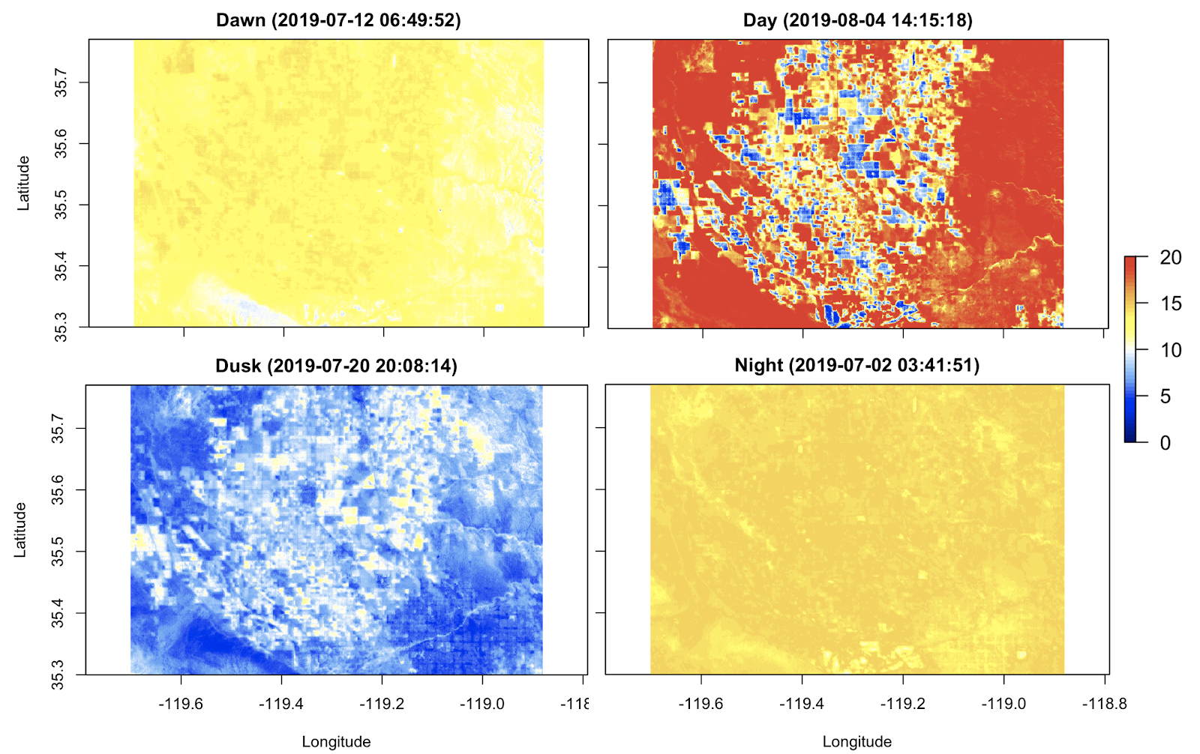
95% Confidence interval: Transmission probability
The nonlinearity of the equations causes constant confidence intervals in temperature to vary when transformed to risk
Introduction
Conclusion
Methods
Modeling
Analysis

Slide 10
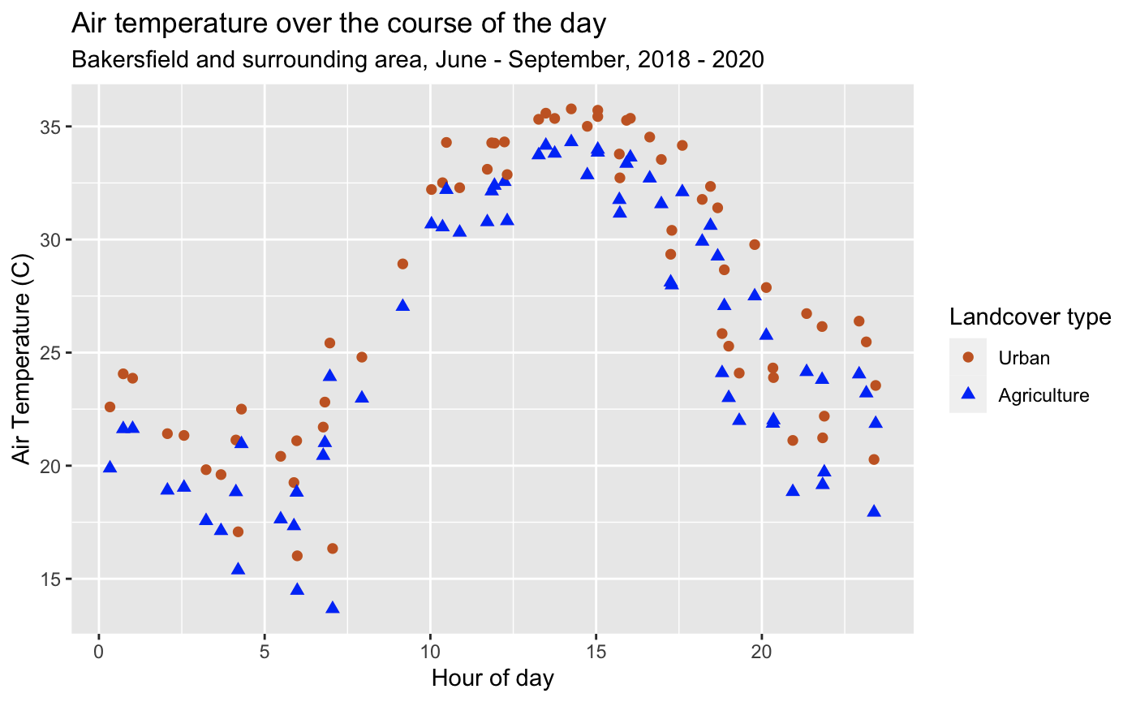
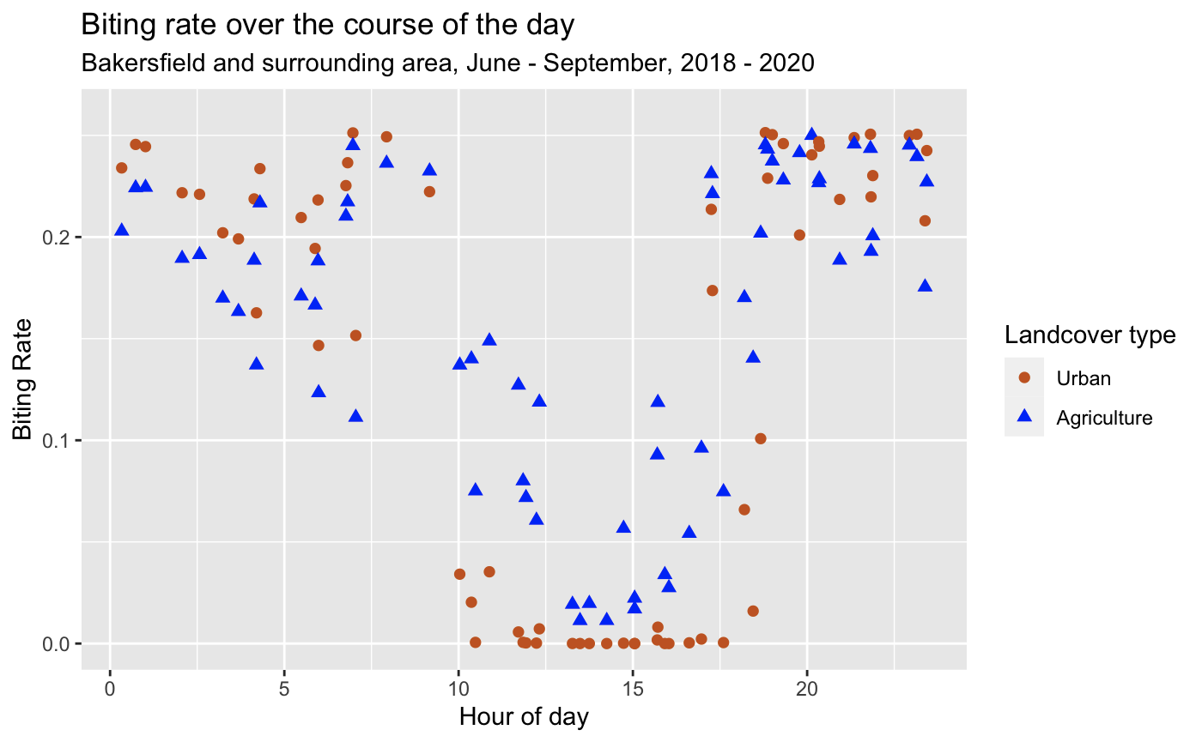
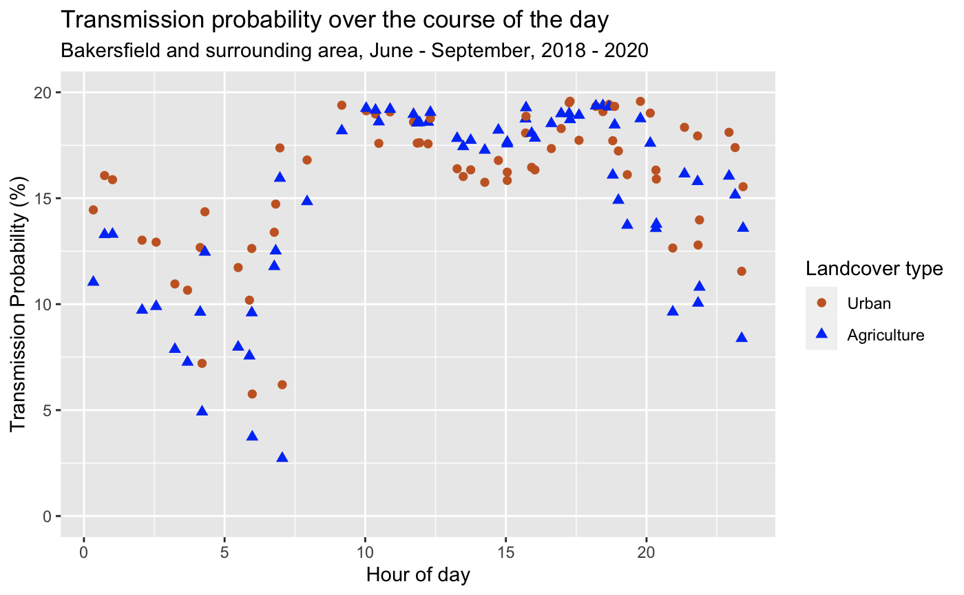
Diurnal cycle
ECOSTRESS allows us to capture the diurnal variations in temperature
Agriculture is generally cooler than urban areas, which translates to lower biting and transmission rates at night and higher biting and transmission rates during the day
Introduction
Conclusion
Methods
Modeling
Analysis

Slide 11
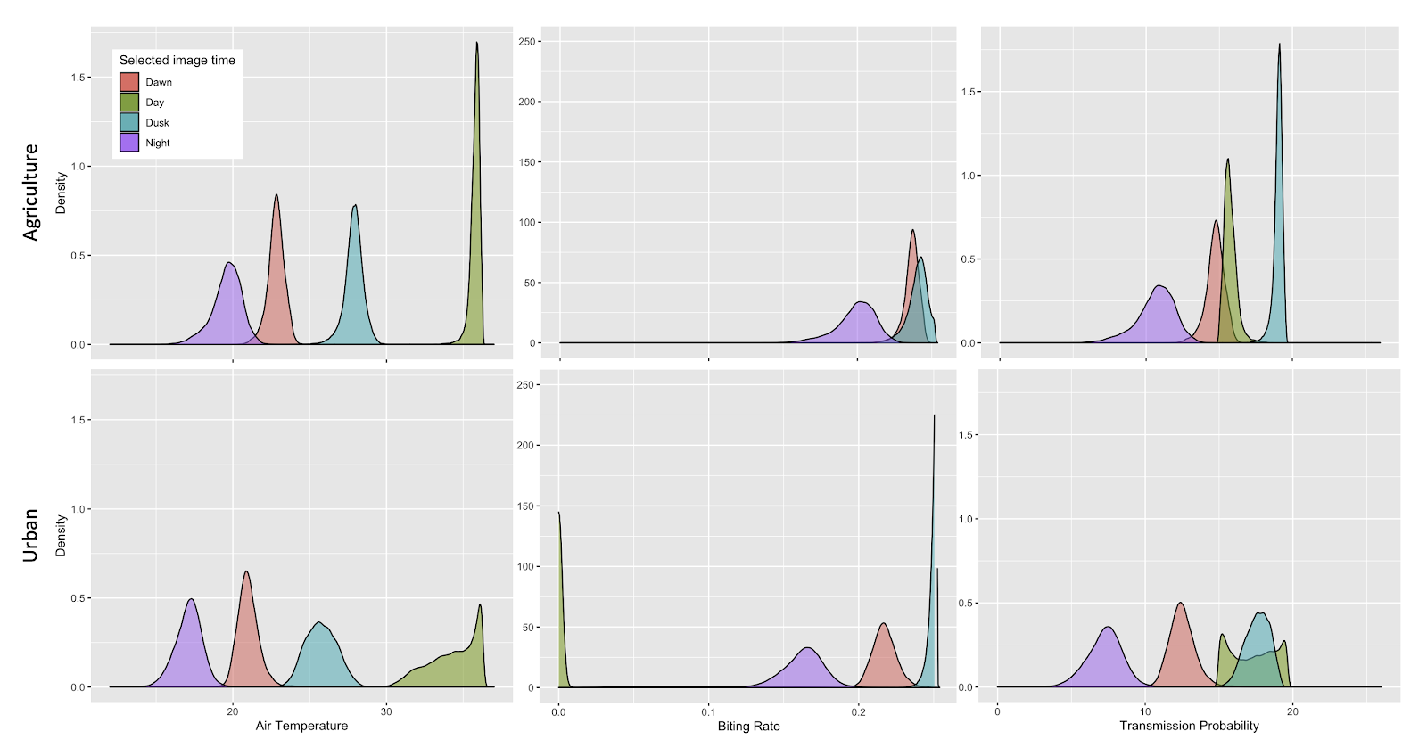
Distribution of pixels in agricultural and urban areas
The values of pixels in urban and agricultural areas for a single image are mostly approximately normally distributed, except agricultural areas during the day.
Introduction
Conclusion
Methods
Modeling
Analysis

Slide 12
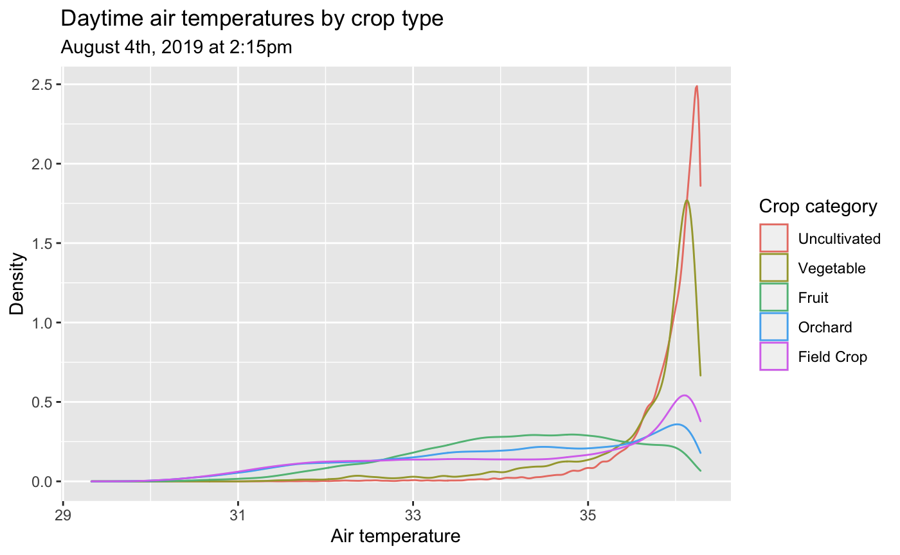
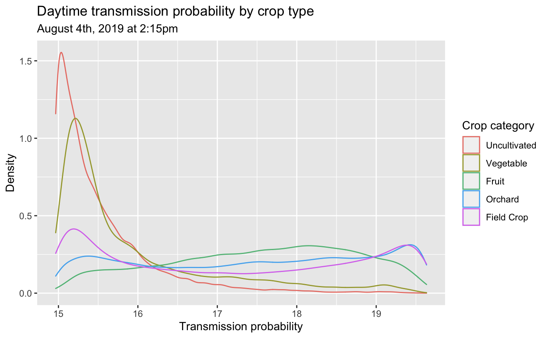
Distribution of daytime pixels by crop type
Uncultivated areas reach higher daytime temperatures than other agricultural areas, leading to lower risk
Introduction
Conclusion
Methods
Modeling
Analysis

Slide 13
Conclusion
ECOSTRESS LST can be used to effectively map WNV risk using laboratory derived equations (R² of .85), though the nonlinearity of these equations lead to widely varying errors through space and time.
Biting and transmission rate risk are lower at night and higher during the day in agricultural areas as compared to urban areas
Uncultivated fields lead to higher temperatures during the day, which actually decreases risk
Introduction
Conclusion
Methods
Modeling
Analysis

Slide 14
Questions?

